Slide 1


Big Levy Investments
Fintech a.y. 2024/2025
Politecnico di Milano
Group 13
Manfredi Giacomo, Pascotto Leonardo,
Tarditi Andrea, Toia Nicolò, Torba Matteo

Slide 2
TABLE OF CONTENTS
1. Aim of the project
2. Customer Classification
2. Replica Construction
4. Anomaly Detection
5. Replica with Anomaly Detection
6. Recommender System
7. WebApp
0
Big Levy Investments

Slide 3
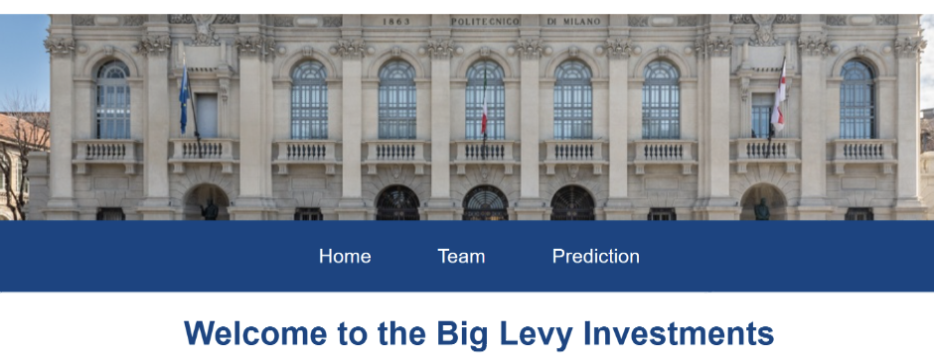
1. AIM OF THE PROJECT
This project integrates Customer Classification, Portfolio Replication and Anomaly Detection to deliver adaptive, personalized investment solutions - providing a robust tool that aligns portfolio allocations with shifting market conditions and each investor’s unique objectives.
Deliver a ready-to-use WebApp that empowers investors and advisors
Personalized portfolio suggestions via client classification (Income vs Accumulation)
Replica strategies that track key equity & bond benchmarks through futures-based models
Real-time anomaly detection to shift exposure during market stress
Cost-aware results by integrating all trading fees
Performance monitoring for transparent, risk-adjusted evaluation
1
Big Levy Investments

Slide 4
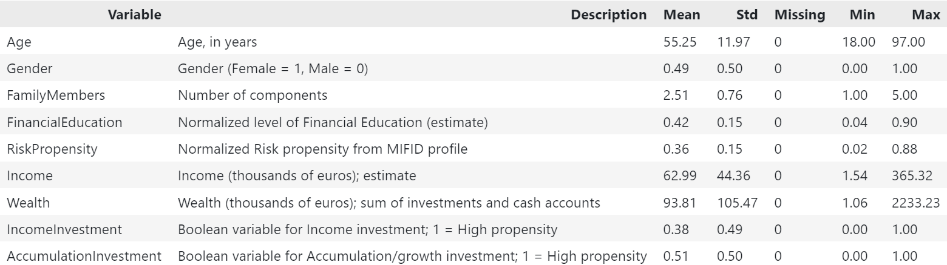
2. CUSTOMER CLASSIFICATION
Purpose & Scope
Core of the Recommender System
Supervised-learning pipeline that predicts two client investment needs:
Accumulation Investment & Income Investment.
Why it matters
Provides fast, data-driven recommendations that plug directly into the advisory workflow.
Built for interpretability (business users) and flexibility (future model swaps).
2
Big Levy Investments

Slide 5
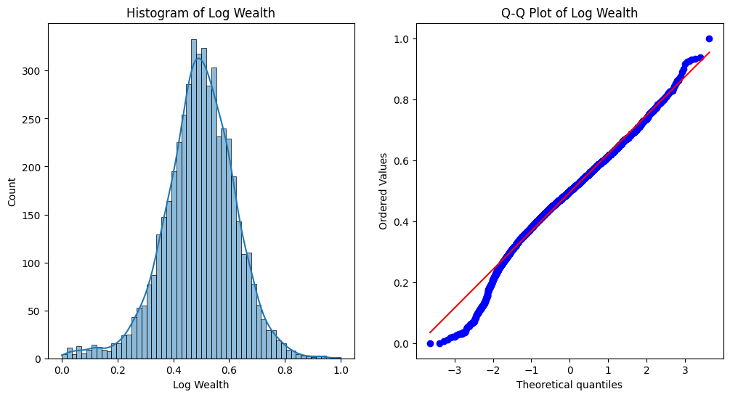
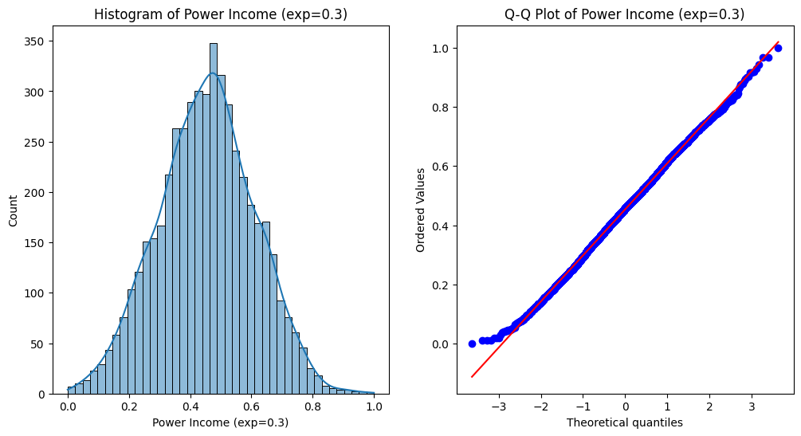
EDA
Input source: Excel workbook
Needs (client features + labels).
Products (product metadata).
Metadata (variable dictionary & summaries).
Transformations
Wealth → log(1 + x) | Income → power (0.3).
Min-Max scale: Age, FamilyMembers, RiskPropensity, transformed Income & Wealth.
Exploratory checks
Class balance, feature distributions, correlation heat-map, box/violin & joint plots - ensuring solid ground before modeling.
3
Big Levy Investments

Slide 6
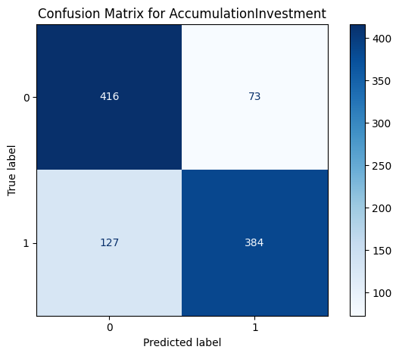
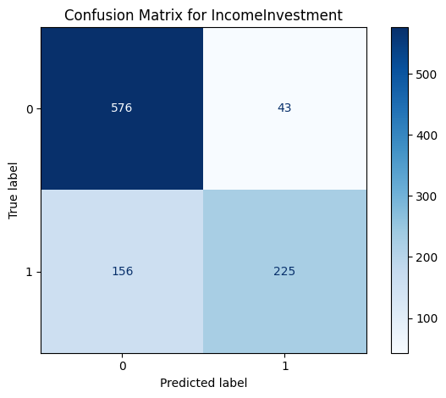
RESULTS
Modeling, Evaluation & Deliverables
Single-target & Joint-target Random-Forest models
Hyper-parameter search with Optuna
MultiOutputClassifier for overlapping needs
Custom evaluation
Standard metrics + penalty score reflecting asymmetric mis-classification costs.
Threshold (τ) tuning to maximize F1 / minimize penalty.
Outputs ready for production
Validation & test reports.
Real-time methods apply full pipeline in one call - scalable, modular, and deployment-ready.
4
Big Levy Investments

Slide 7
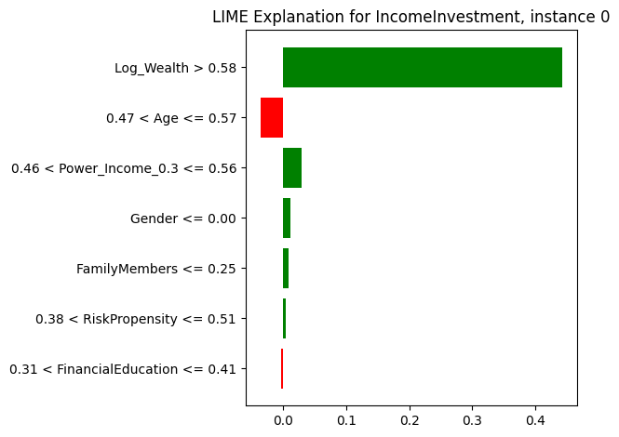
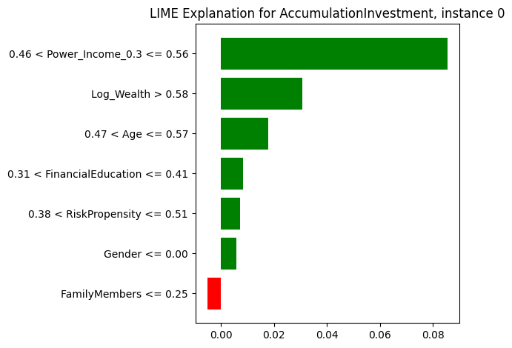
INTERPRETABILITY
A variety of feature-importance techniques was incorporated to clarify the drivers of the model’s predictions. In regulatory and production contexts, machine-learning systems must be able to explain the results they generate.
Accordingly, local interpretability methods were added to identify the key features influencing each individual observation.
5
Big Levy Investments

Slide 8
3. PORTFOLIO REPLICA
A universe of indices and futures was used, and - without insight into the target index’s composition - the models were tasked with replicating its return profile.
Three reference portfolios have been replicated:
Portfolio | Index Benchmark | Essence | Risk / Return Profile
Equity* | MSCI World - MXWO | Globally diversified basket of large & mid-cap stocks | Highest growth potential; highest volatility
Bond | Bloomberg Global Aggregate - LEGATRUU | Broad investment-grade fixed-income universe | Capital preservation & steady income; lowest volatility
LifeStrategy 80/20 | 80 % MXWO 20 % LEGATRUU | Classic equity-bond mix for balanced exposure | Moderate growth with downside cushion
* The graphs in the Portfolio Replica section of this presentation refer to the Equity Portfolio. The results for the other portfolios can be observed in the Jupyter Notebook named Group13_Final_Project.ipynb.
6
Big Levy Investments

Slide 9
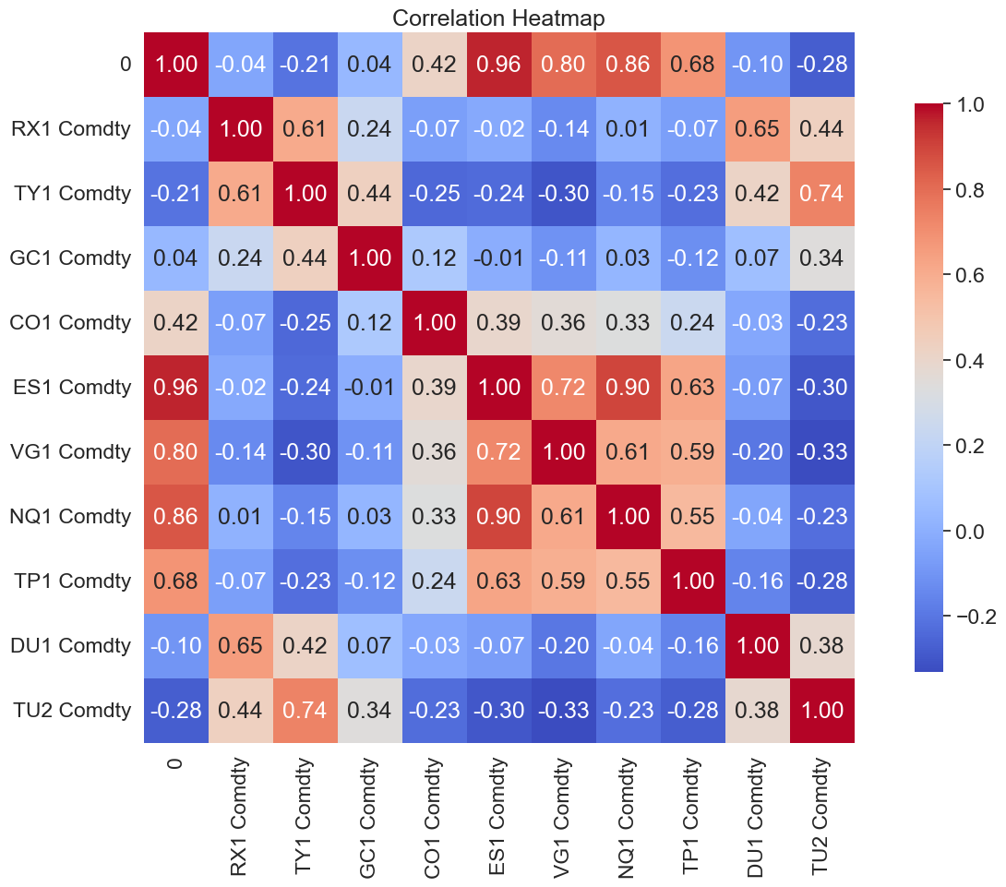
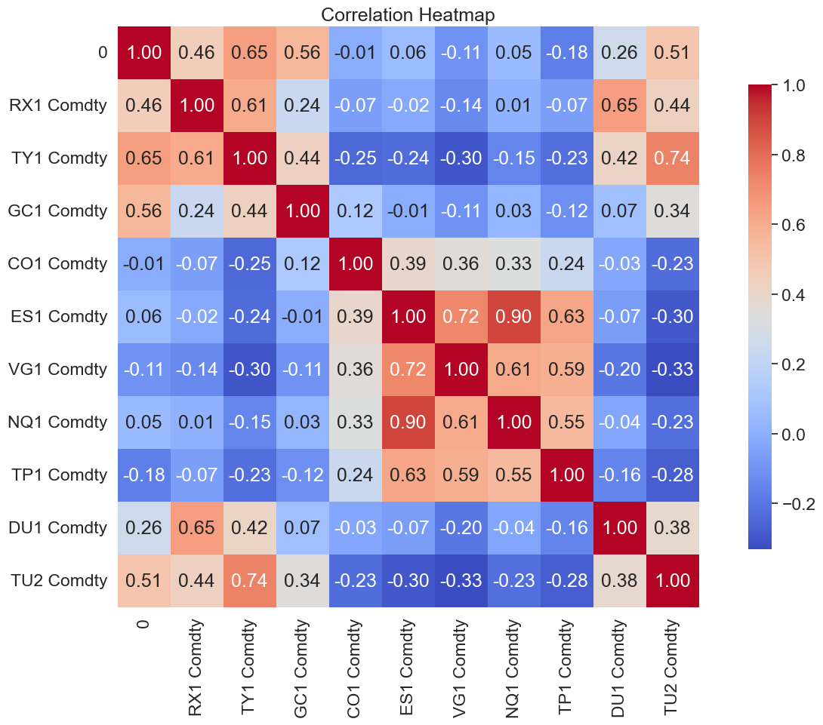
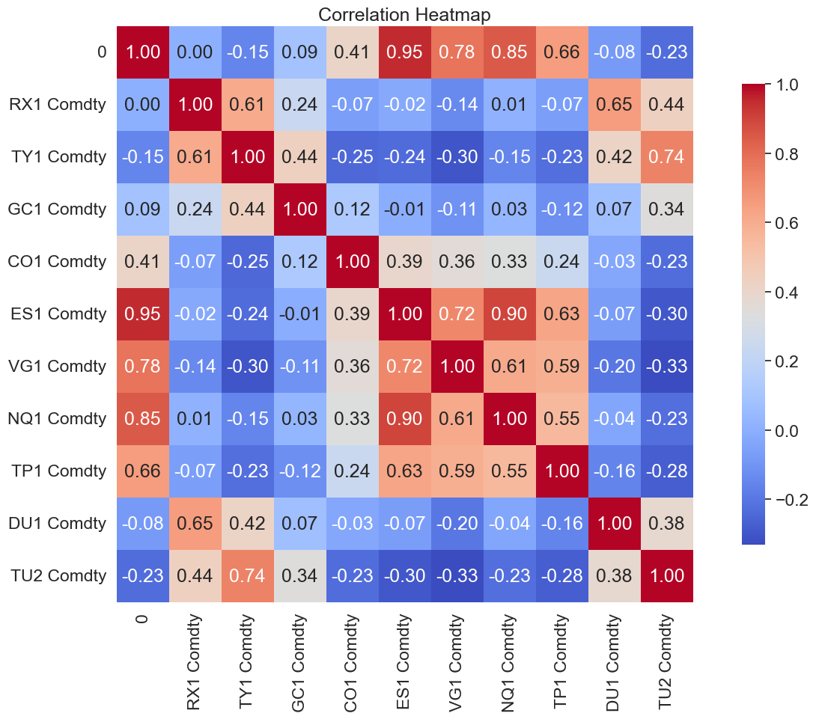
CORRELATION ANALYSIS
Equity Portfolio
Very strong anchor: ES1 (S&P 500 mini) clocks a ρ ≈ 0.96 with the target.
A clear “equity cluster” (ES1, VG1, NQ1, TP1) all inter-correlated above 0.70, while rate futures (RX1, TY1) are weak/negative.
Bond Portfolio
Flatter matrix – no future tops
ρ = 0.65 with the target (best is TY1, the 10-year T-Note).
Cross-future links mostly sit in the 0.25 – 0.55 band; some pairs even drift slightly negative.
Life Strategy 80/20 Portfolio
Hybrid profile:
Equity leg survives - ES1 still ρ ≈ 0.90 with target.
Bond influence visible – TY1 at ρ ≈ 0.61.
Matrix looks like a tempered version of the equity map.
Target Index
Target Index
Target Index
Target Index
Target Index
Target Index
7
Big Levy Investments

Slide 10
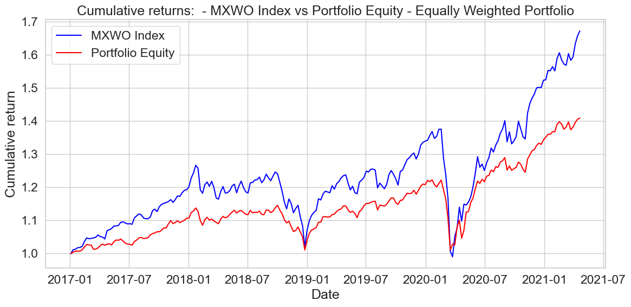
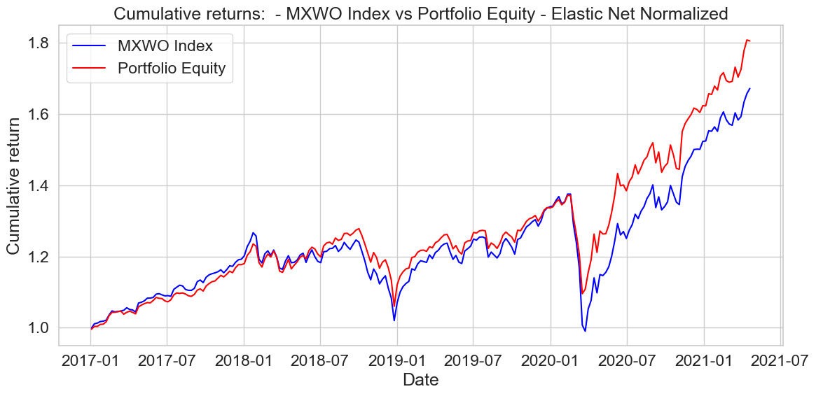
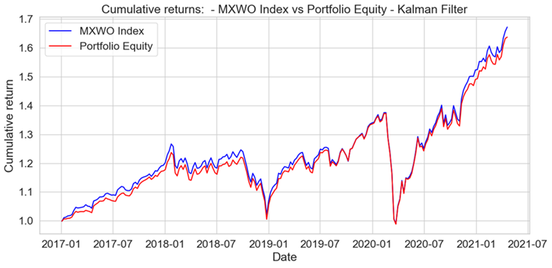
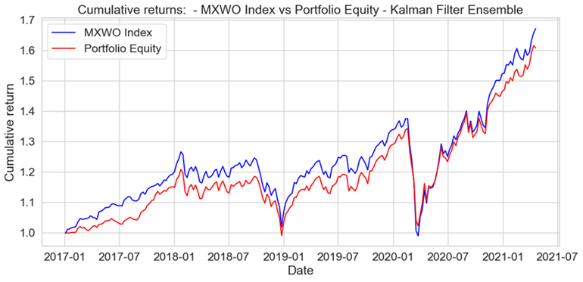
REPLICATION METHODS
Equally Weighted Portfolio (EW): benchmark method, offering simplicity and an intuitive baseline for replication.
Elastic Net Regression (EN): Combines L1 and L2 penalties for balanced feature selection and stable weights; might struggle with non-linear market dynamics.
Kalman Filter (KF): dynamic model that adapts weights over time, adjusting to market fluctuations. Well-suited for non-stationary data but sensitive to noise in observations. Among the considered models, KF has the shortest rebalancing window, hence it is the model with the highest costs.
Ensemble Kalman Filter (EKF): The Ensemble Kalman Filter extends the classic Kalman Filter by maintaining an ensemble of possible state estimates, each updated independently to introduce flexibility and robustness to non-linearities and uncertainties. While more complex, this ensemble-based approach effectively captures the variability in optimal weights under different scenarios, producing a more adaptive and robust replication.
8
Big Levy Investments

Slide 11
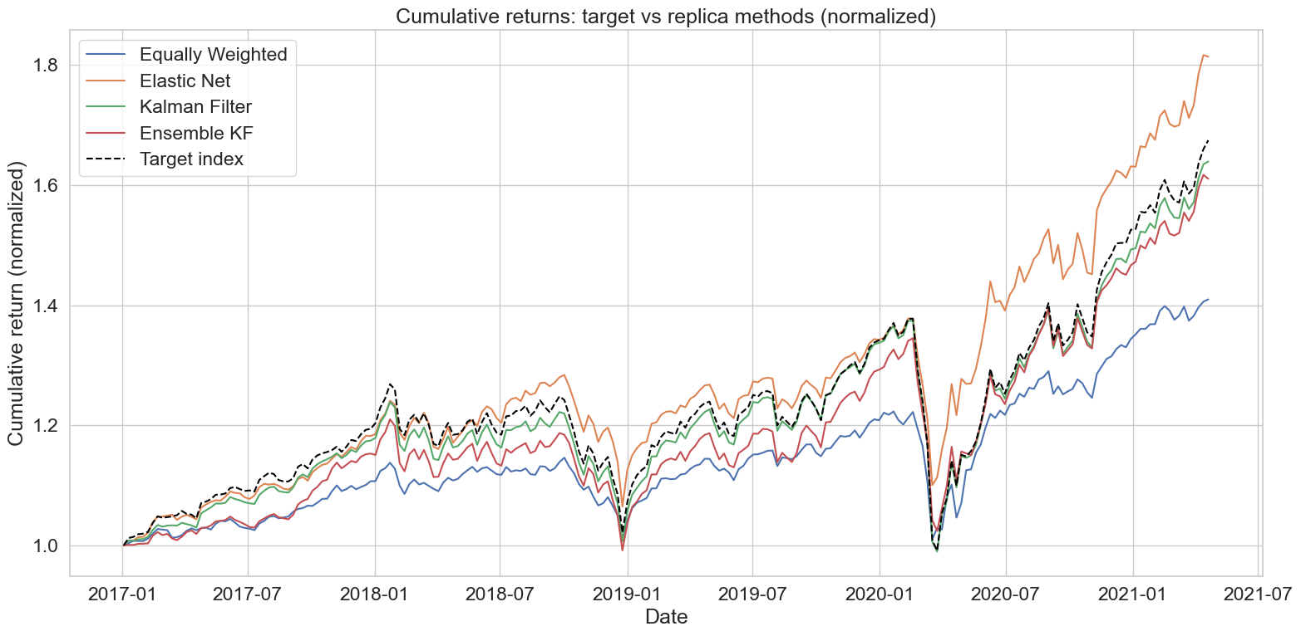
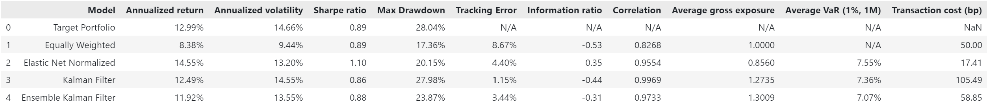
NOTE:
Comparing the replication methods, we can appreciate that the Ensemble Kalman Filter delivers performance nearly as strong as the Kalman Filter, while almost halving the transaction costs!
9
Big Levy Investments

Slide 12
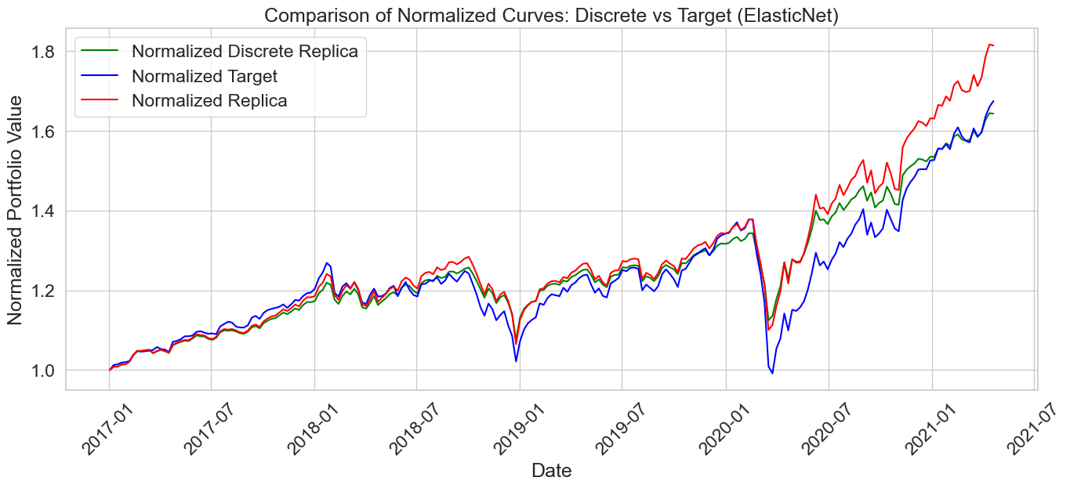
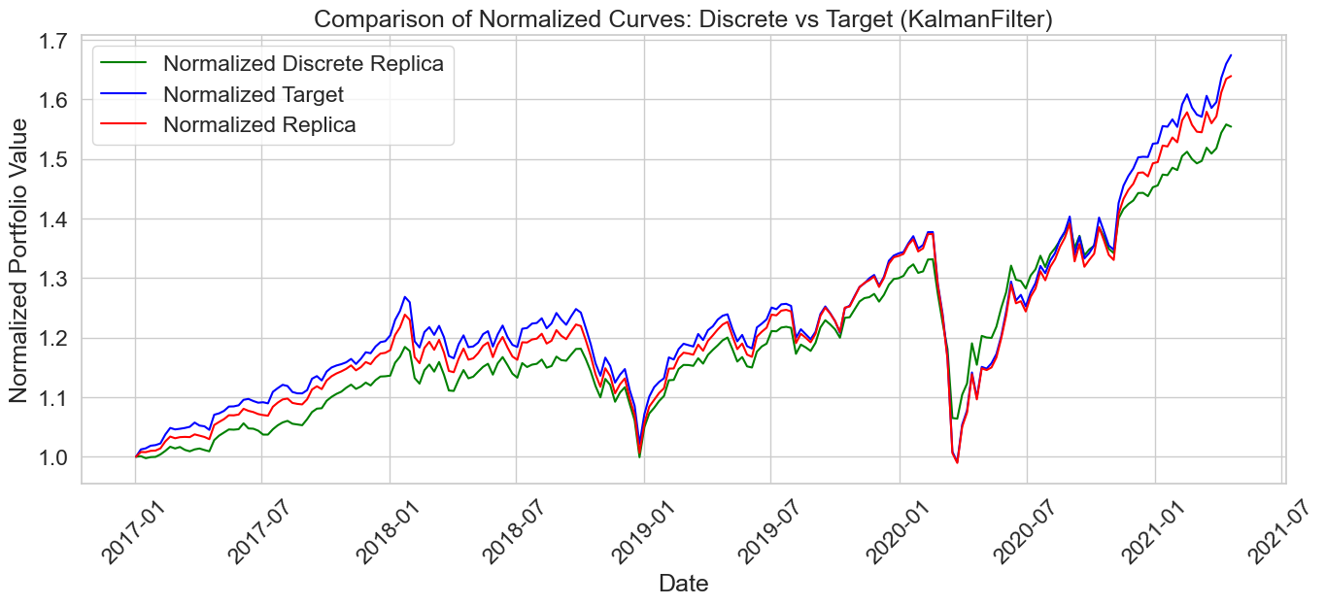
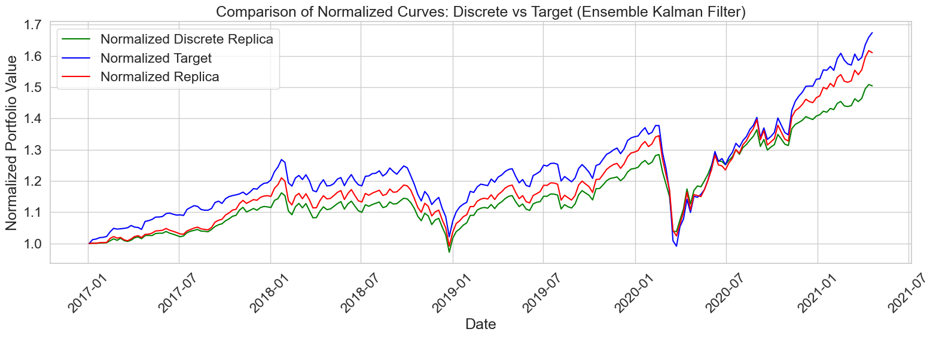
DISCRETE PORTFOLIO ALLOCATION
The analysis now shifts from continuous portfolio weights to a discrete allocation framework, in which weights are converted into actual positions for a portfolio of fixed value.
This representation more accurately mirrors the practical trading and rebalancing constraints of real markets.
10
Big Levy Investments

Slide 13
DISCRETE PORTFOLIO ALLOCATION
The analysis now shifts from continuous portfolio weights to a discrete allocation framework, in which weights are converted into actual positions for a portfolio of fixed value.
This representation more accurately mirrors the practical trading and rebalancing constraints of real markets.
Portfolio | TER EN | TER KF | TER EKF
Equity | 0.08% | 0.26% | 0.17%
Bond | 0.19% | 0.42% | 0.36%
Life Strategy 80-20 | 0.08% | 0.30% | 0.17%
10

Slide 14
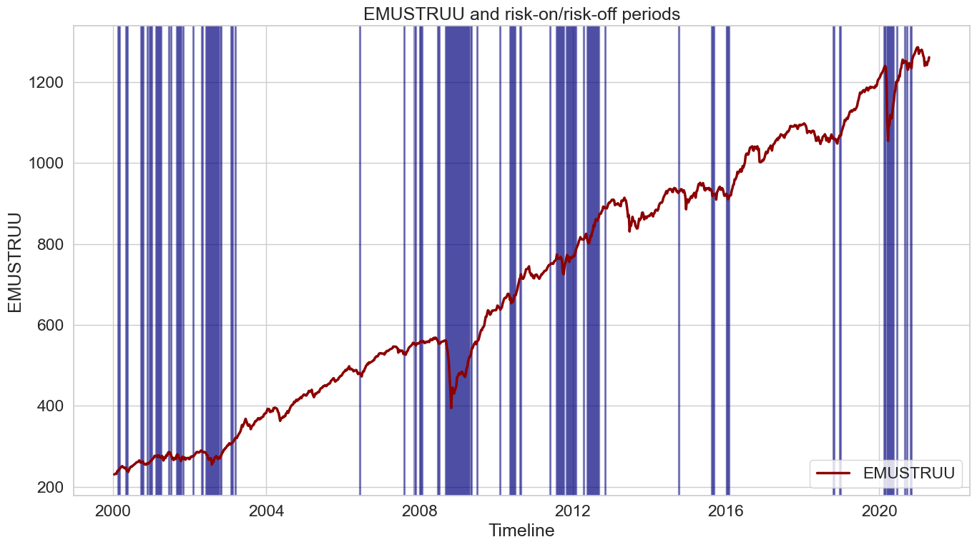

4. ANOMALY DETECTION
This section analyzes anomaly detection in financial time series. Only anomalies that impacted the considered index were considered in each portfolio replica.
FINANCIAL SCORE
Business-oriented classification metric which measures the financial impact of classification errors based on average standardized returns for normal (mean normal) and anomaly (mean anomaly) periods, weighted by their relevance.
Cost per error:
False Positives (Y = 1) incur a penalty equal to mean anomaly.
False Negatives (Y = 0) incur a penalty equal to mean normal.
Correct classifications carry no penalty.
Total cost = Sum of all row-level penalties in the test set.
Worst-case cost = Penalty that would result if every prediction were wrong.
A value of 1 denotes perfect classification, whereas 0 represents the worst possible outcome.
$$Financial Score=1−\frac{Total Cost}{Worst Case Cost}$$
11
Big Levy Investments

Slide 15
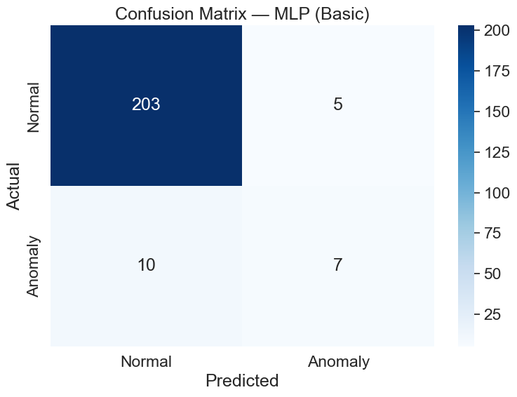
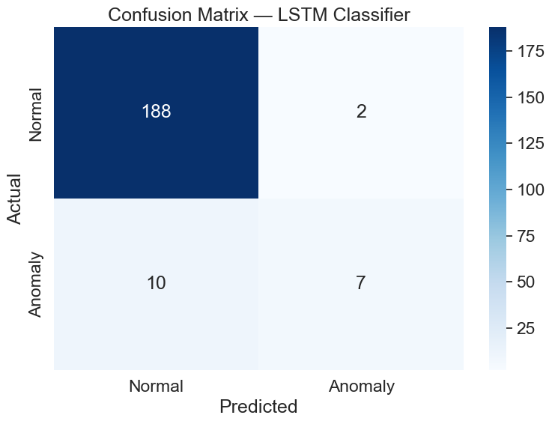

ANOMALY DETECTION MODELS
MLP (Basic): A simple multi-layer perceptron neural network trained to classify normal vs anomaly periods.
MLP (Optuna Tuning): The MLP model with Optuna hyperparameters tuning for better performance.
LSTM Autoencoder: Recurrent neural network autoencoder to detect anomalies by reconstructing input sequences and identifying large reconstruction errors.
LSTM Classifier: An LSTM-based model directly trained to classify sequences as normal or anomalous.
LSTM Classifier with Tuned Threshold: The LSTM classifier with an adjusted classification threshold.
(a) Equity Portfolio
(b) Bond Portfolio
(c) Life Strategy 80-20 Portfolio
Confusion Matrices of the three considered portfolios best performing models.
Remind that for each model only the anomalies which had an impact on the benchmark indexes where considered.
12
Big Levy Investments

Slide 16
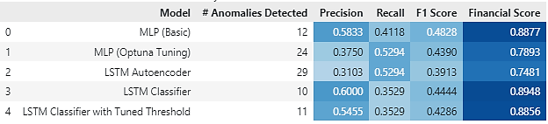
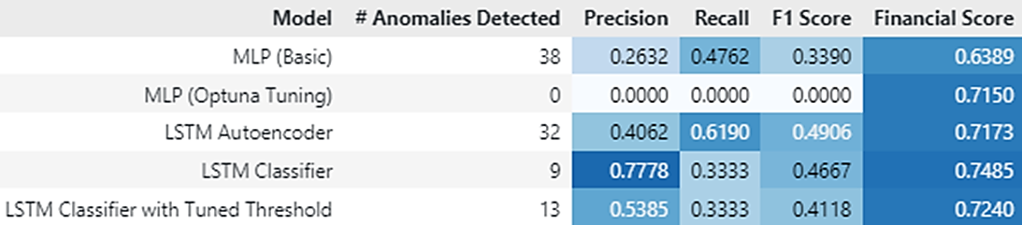
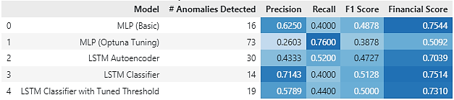
ANOMALY DETECTION RESULTS
For each Replicating Portfolio a different Model was chosen, based on a combination of different metrics.
Equity Portfolio: The MLP (Basic) model was chosen because it has the second highest Financial Score and performs as well as, or better than, the LSTM Classifier across other metrics.
(a) Equity Portfolio
Bond Portfolio: The LSTM Classifier was chosen, since it outperforms the other models in almost every metric.
(b) Bond Portfolio
Life Strategy 80-20 Portfolio: The LSTM Classifier was chosen since it has the highest values of Precision and F1 score and it has the second highest Financial Score.
(c) Life Strategy 80-20 Portfolio
13
Big Levy Investments

Slide 17
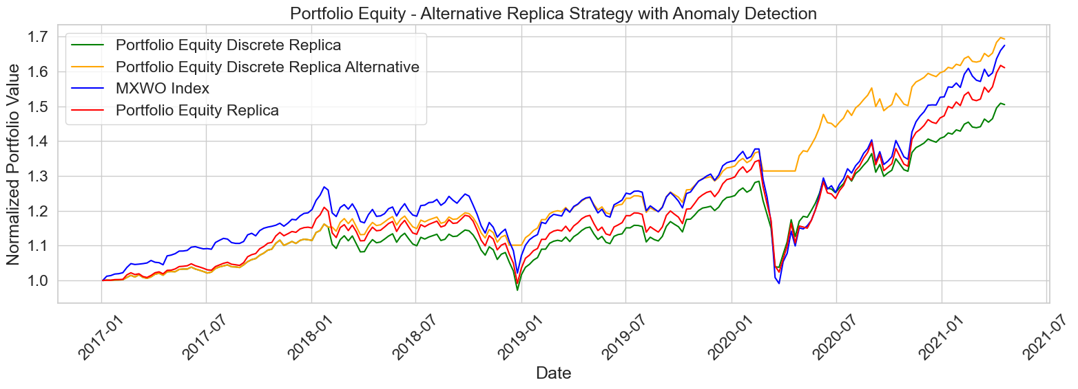
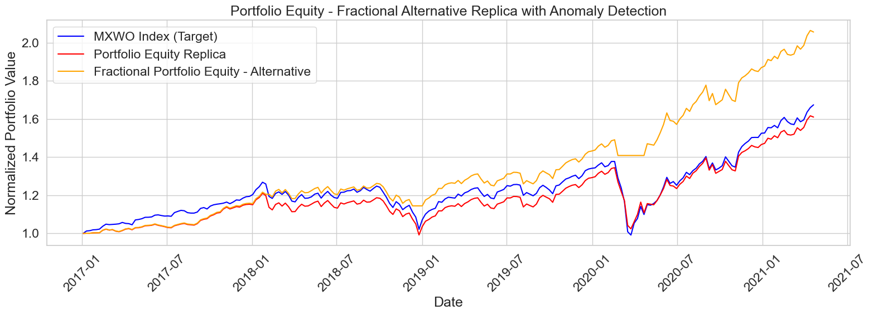
5. REPLICA WITH ANOMALY DETECTION
We combined the portfolio replication strategies with the anomaly detection signals.
Whenever an anomaly was detected, we dynamically shifted the allocation to cash by setting the portfolio weights to zero, testing how this approach influenced overall performance and risk.
Overlay | Weights | Advantage | Drawback
Discrete | Rounded positions for a fixed-value book. | Real- world tradability | Extra noise & costs
Fractional | Original fractional weights from the replication model. | Higher risk-adjusted returns; keeps model precision | Requires fractional execution capability
(a) Equity Portfolio
13

Slide 18
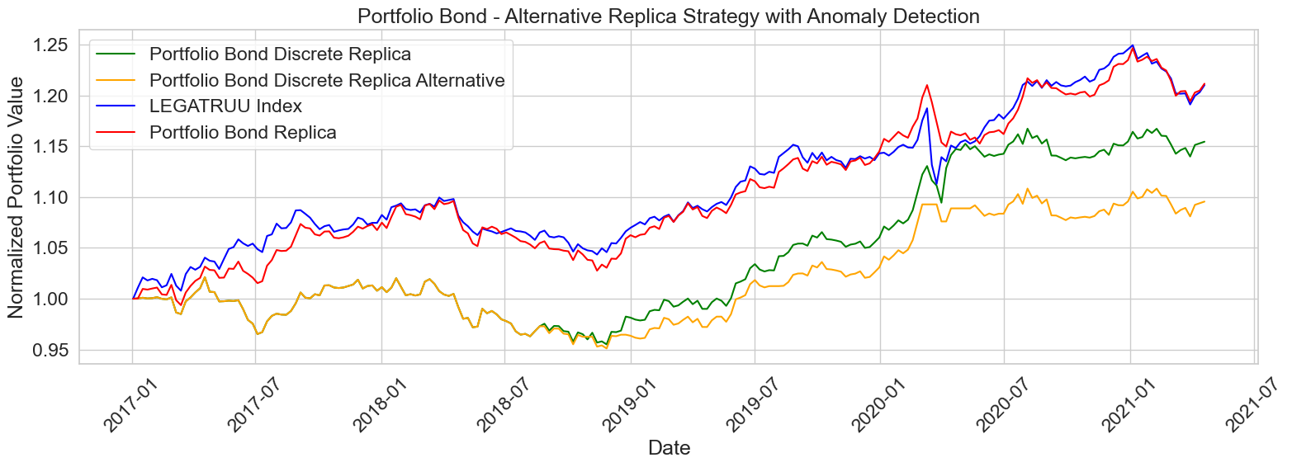
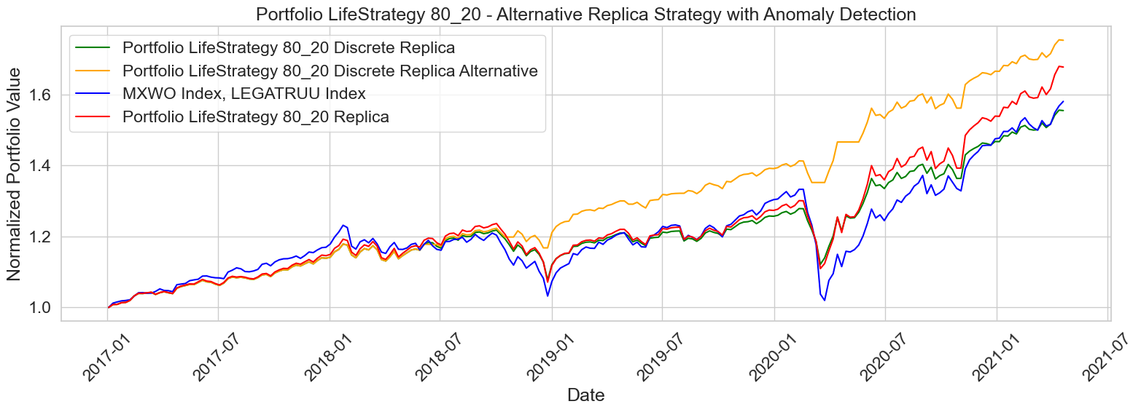
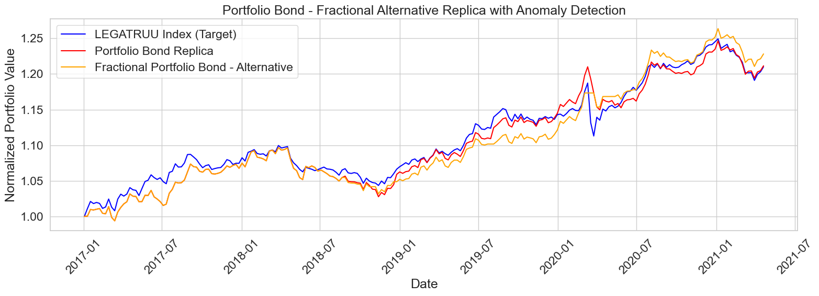
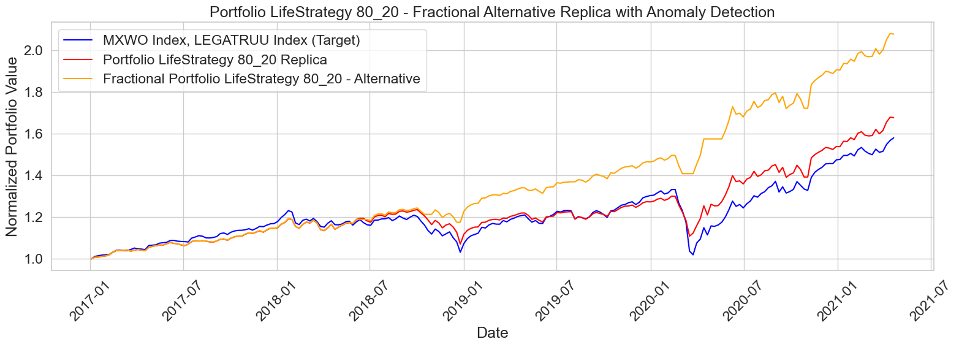
(b) Bond Portfolio
(c) Life Strategy 80-20 Portfolio
Key Findings:
Continuous-weight overlay preserves model precision and delivers the best risk-adjusted results.
Discrete overlay is more realistic but introduces extra implementation noise and transaction costs.
14

Slide 19
5. REPLICA WITH ANOMALY DETECTION
We combined the portfolio replication strategies with the anomaly detection signals.
Whenever an anomaly was detected, we dynamically shifted the allocation to cash by setting the portfolio weights to zero, testing how this approach influenced overall performance and risk.
Two overlay methods were considered.
Overlay | Weights | Advantage | Drawback
Discrete | Rounded positions for a fixed-value book. | Real- world tradability | Extra noise & costs
Fractional | Original fractional weights from the replication model. | Higher risk-adjusted returns; keeps model precision | Requires fractional execution capability
14
Big Levy Investments

Slide 20

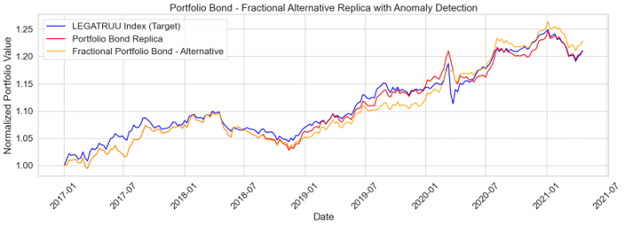
Key Findings:
Continuous-weight overlay preserves model precision and delivers the best risk-adjusted results.
Discrete overlay is more realistic but introduces extra implementation noise and transaction costs.
(a) Equity Portfolio
(b) Bond Portfolio
(c) Life Strategy 80-20 Portfolio
15
Big Levy Investments

Slide 21



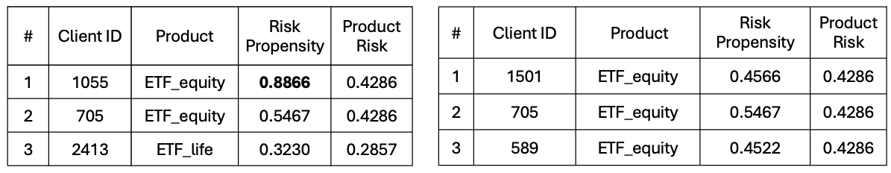
6. RECOMMENDER SYSTEM (NBA ALGORITHM)
The classified customer profiles were linked to the portfolio options to create a personalized investment recommender.
Given a new customer’s segment, the system suggests one of the six portfolios (or a blend), aiming to match the investor’s risk-return needs. The recommender was tested on a hold-out set, measuring how often its recommendations align with a reference (simulated) “optimal” choice.
Evidence in the test set show that our model can generalize beyond the training sample. In practice, this means the approach could realistically support portfolio selection in a wealth-management context, offering personalized allocations that resonate with each investor’s profile.
16
Big Levy Investments

Slide 22
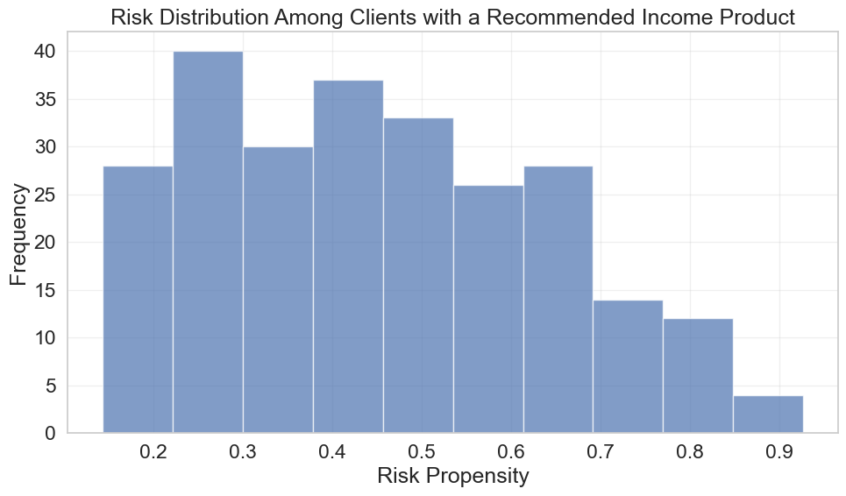
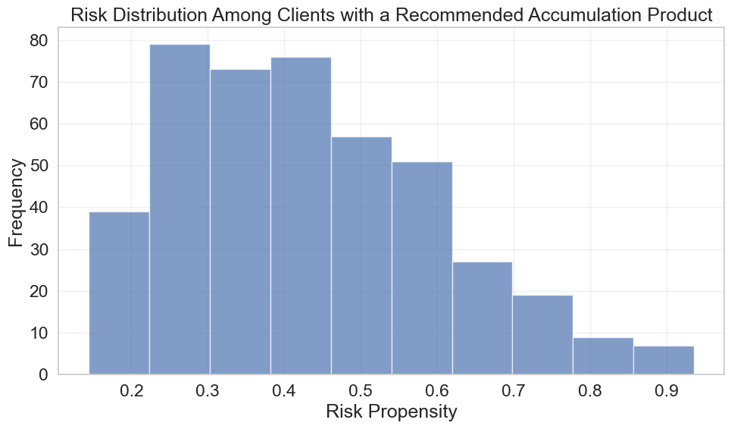
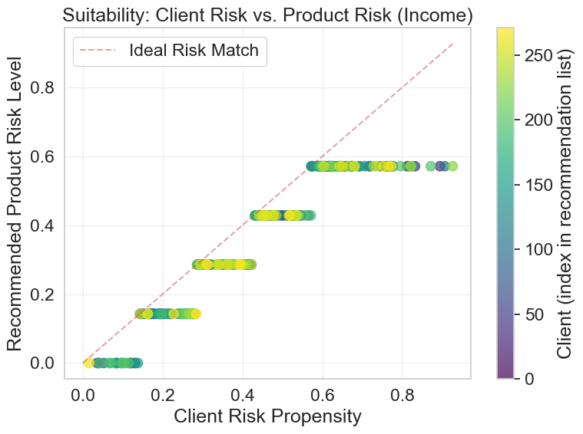
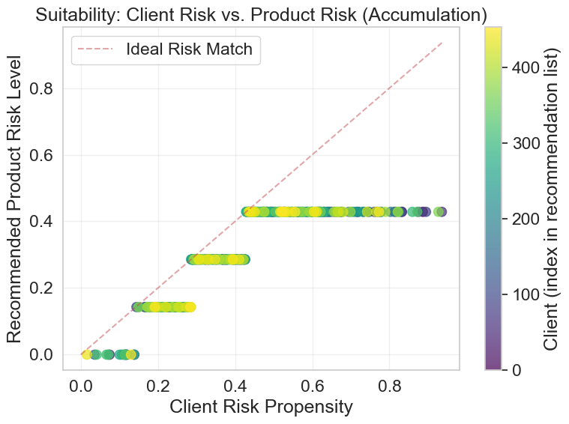
17
Big Levy Investments

Slide 23


7. VISIT OUR WEB APP
To tie our work together we decided to develop a WebApp which gives a great idea of real-world applications and possible development of our work.
Find it at:
https://gm46.pythonanywhere.com/
18
Big Levy Investments

